Slide 1

FMCG Sales Analysis
Dhivya Swaminathan

Slide 2
The Data set and the problem statement
The data set is from the FMCG domain and following are the key points:
Consists of 2500+ variants manufactured by many, from many brands and sub-brands, having one or more primary benefits for one or more body-parts.
For each instance of the variant, there are Volume sales, Revenue and No of Stores for all months of three years – 2011, 2012 and 2013.
Additionally, there is another data set that consists of Media spends of Two particular variants for one and half years.
Problem-Statement:
Brand-434 is a popular brand for use in bodypart-1. It has recently launched a variant called "variant-1163". The brand is interested in increasing price of "variant-1163" by 10% in the next couple of months. Would you recommend it?
A major player in this segment is "brand-311" along with its variant "variant-734". It is of interest to understand how this variant is affecting sales of "variant-1163"

Slide 3
Why isn’t this problem as simple as it sounds?
To know what is the aftermath of price increase, we need to know the behaviour of the product in the market on the whole.
By this, what is implied?
How is my volume sales affected when price is increased by 10%? (does it increase or decrease or not change at all?)
What effect does the Market share have on Sales?
What effect does the Media Spends have on Sales?
This analysis, again, is not as simple as it sounds, but requires hours of diligent work to come to valuable insights after which we should come to a conclusion with concrete proofs for our decisions.

Slide 4
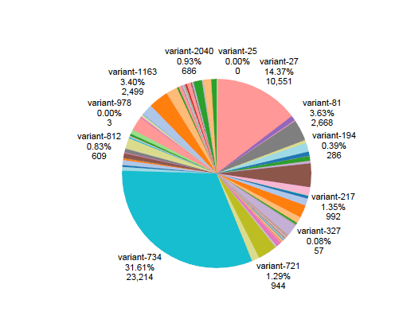
Market share of Variants of same primary benefit and Body part
This is a medieval analysis of various players in the market and the shares they hold

Slide 5
Evolution of Research Question
Stage1: Does Price affect Sales?
Stage2: Can Price be increased without decreasing the sales?
Stage3: What is the threshold of increase in price up to which sales doesn’t drop?
Stage4: What is the Maximum Rise% in Price up to which sales does not drop?
Stage5: What is the Maximum Rise% up to which change in volume with respect to previous month is greater than zero? i.e.,
MAX RISE% upto which dv/dm > 0

Slide 6
Classifier Algorithms
In order to identify all the competitor variants, a classifier algorithm is devised - This is to assess the effect of their sales on ours.
In order to identify supplementary variants, a classifier algorithm is devised – This is to assess the effect of our competitor on their sales (These follow trends similar to us).
(WHY? Basically, the variants identified as our supplementary ones, are lab rats for our experiments. Except that, we are not going to induce our decisions on them, but see if they have made any such decisions that have affected their sales)

Slide 7
Clarifying the above said with an analogy
Consider the telecom industry, let us assume the markets have the following companies alone- Vodafone, Airtel, Idea and Aircel. Now, we have to answer Vodafone’s problem statement – Can data plans’ prices be increased by 10%.
Competitor analysis:
To find those companies that directly affect our sales. For example, let us take Airtel to be our competitor. Airtel introduced a new offer leading to a boost in their sales. This in turn resulted in high churn rate in Vodafone. Therefore, a peak in their sales means a dip in ours’.
Supplementary Analysis:
To find who all follow patterns similar to us. Consider here that Idea and Aircel are our supplementary companies. A dip in our sales means a dip in theirs. Similarly, a peak results in a peak i.e., they follow our trend. Therefore, we can use them as lab rats. In a business tone, we can check if they had raised their product’s price, if yes, then how was their sales affected. This is because, they mirror our trend. Our competitor is their competitor too. Therefore, Enemy of our enemy is our friend and hence, we analyse their trend for our benefit.

Slide 8
Supplementary analysis
The Algorithm generates an 8 digit code based on the below strategy
Each Quarter’s dv value is assigned any one of the following four categories and assigned a value as shown
High growth in sales – (if dv/dq > mean (high growth sales)) – (Value assigned – 1)
Low growth in sales – (if dv/dq < mean (Little growth sales) and dv/dq>0)- (Value assigned – 2)
Low Drop in sales – (if dv/dq < 0 and dv/dq >(Little drop sales))- (Value assigned – 3)
High Drop in sales – if(dv/dq < mean(High drop sales)) - (Value assigned – 4)
Drawback: There is an almost nil chance that two products follow the exact same trend in the market
A tweak to overcome the drawback:
A new variable – MATCH% is introduced.
MATCH% = (Total number of quarters matched/ 8 (total number of quarters considered here))x100
For example, , variant-1163 has a value of 41114114 and variant 734 has 41214111. variant-734 ‘s MATCH% with variant-1163 is ((6/8)x100)=75%

Slide 9
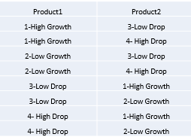
Competitor analysis
This employs the same algorithm, except that, instead of MATCH%, we use a new variable Competitor Quotient %
The following pair-checks will be done:
So with the 8 digit code generated for each variant, the one that has the highest Competitor Quotient % (one that has most number of matches with the table template shown above), will be taken as competition.

Slide 10
Regression Analysis
Some new findings include finding regression separately for price and number of stores on Volume sales
On implementing multiple regression for the same, the results are as follows:

